Slide 1
OHDSI Tutorial: Patient-level predictive modelling in observational healthcare data
Faculty:
Chungsoo Kim (Yale)
Egill Fridgeirsson (Erasmus)
Jenna Reps (Johnson & Johnson)

Slide 2
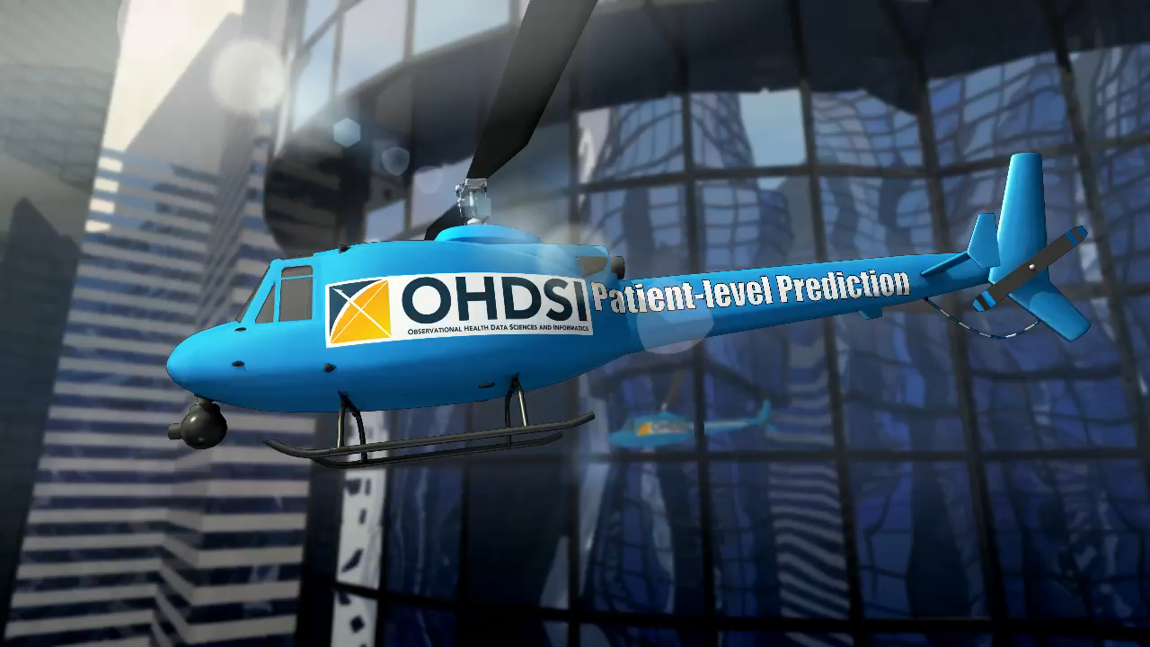
The journey toward Patient-Level Prediction

Slide 3
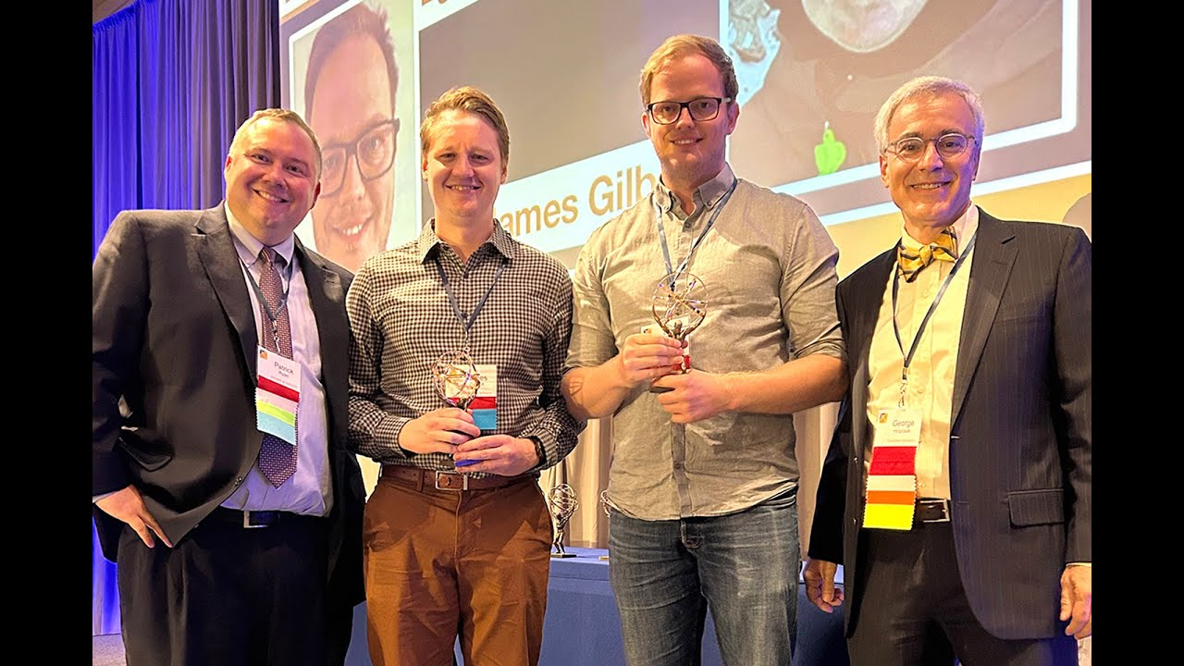

Faculty
Egill Fridgeirsson (Erasmus) | Chungsoo Kim (Yale) | Jenna Reps (J&J)
Slides can be found on our Github:
https://github.com/OHDSI/Tutorial-PLP
https://www.ohdsi.org/who-we-are/collaborators/

Slide 4
Today’s Agenda
Time | Topic
12:45 - 13:00 | Get settled, get laptops ready
13:00 – 13:30 | Presentation: What is Patient-Level Prediction
13:30 – 13:45 | Exercise: Design your own prediction task
13:45 – 14:00 | Break
14:00 – 14:30 | Presentation: OHDSI Patient-Level Prediction With Best Practices
14:30 – 15:00 | Exercise: Design your own model
15:00 – 15:15 | Break
15:15 – 16:00 | Presentation: Using R to implement your design and run a network study
16:00 – 16:15 | Demo: Exploring study results via shiny
16:15 - 16:30 | Break
16:30 - 16:45 | Presentation: Federated Learning
16:45 – 17:00 | Lessons Learned and Feedback

Slide 5
Welcome to the Patient-Level Prediction Tutorial
Chungsoo Kim

Slide 6
Kep Topics to cover in 30 mins
What is prediction vs other OHDSI analyses
Why is prediction important
The components of a prediction task – T/O/TAR
Example prediction tasks
Considerations – clinical utility/is there an intervention/is the outcome rare/can we phenotype

Slide 7
OHDSI’s Mission
To improve health, by empowering a community to collaboratively generate the evidence that promotes better health decisions and better care.
Hripcsak G, et al. (2015) Observational Health Data Sciences and Informatics (OHDSI): Opportunities for observational researchers. Stud Health Technol Inform 216:574–578.

Slide 8




A caricature of the patient journey
Disease
Treatment
Outcome
Conditions
Drugs
Procedures
Measurements
Person time
Baseline time
Follow-up time
0

Slide 9
Questions asked across the patient journey
Disease
Treatment
Outcome
Which treatment did patients choose after diagnosis?
Conditions
Which patients chose which treatments?
Does one treatment cause the outcome more than an alternative?
Drugs
Procedures
Measurements
How many patients experienced the outcome after treatment?
Does treatment cause outcome?
Person time
Baseline time
Follow-up time
What is the probability I will develop the disease?
0
What is the probability I will experience the outcome?

Slide 10
Complementary evidence to inform the patient journey
Clinical characterization:
What happened to them?
observation
Patient-level prediction:
What will happen to me?
Population-level effect estimation:
What are the causal effects?
inference
causal inference

Slide 11
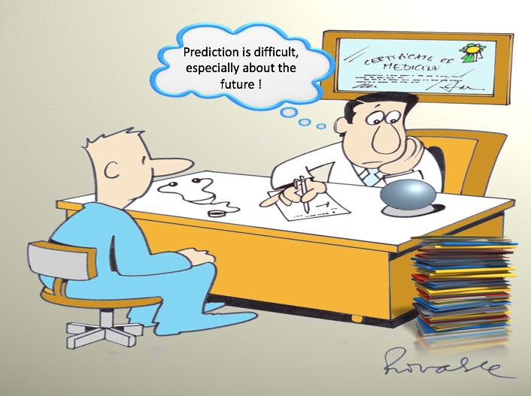
Clinicians are confronted with prediction questions on a daily basis. What options do they have?
Deny ability to predict at the individual patient level
Quote an overall average to all patients
Provide a personalized prediction based on an advanced clinical prediction model
Utilize knowledge and personal experience
Notes:
Doctors are asked to give predictions on a daily basis as shown in this cartoon of a atrial fibrillation patient with the question “What is my risk of stroke in the next year now I have Atrial fibrillation?”
What are the options a clinician has when confronted with a prediction question?
He could of course deny the ability to predict at the individual patient level and, although this is not the answer the patient wants to hear, this is sometimes to most sensible answer to give.
He could also quote an overall average to all patients with same age an gender, which is what Patrick has shown in his presentation about data characterization.
Often the doctor tries to give an answer based on his knowledge and experience with patients that have a comparable medical history as the patient in front of him.
This task is very difficult for a a human to fullfill because prediction is rarely based on a single factor but is a combination of multiple predictiors. The big question here is which are the predictors that need to be taken under consideration?
Ideally, he would have access to a prediction model that will predict the risk of this patient with all his medical history. This requires the development of an advanced patient-level prediction model.
As the great Danish physicist Niels Bohr said ”It is very difficult to predict, especially the future”. It is hard to know the current state you are in let alone what will happen to you in the future.
I think Bohr is right, it is a challenging task, but still I believe that in the data rich time we currently live and with the computer power we have for our modelling work, we are able to make big contributions to the field of patient-level predictive modelling.
This is the reason we have put patient-level predictive modeling high on the agenda of the OHDSI initiative and have created a patient-level prediction workgroup started lst year let by me and Jenna Reps.
We believe OHDSI is especially well equipped to move this field further because of the enormous energy that has been put in the standardization of data through the OMOP CDM and the vocabulary and the excellent multi-disciplinary expertise that is available.

Slide 12
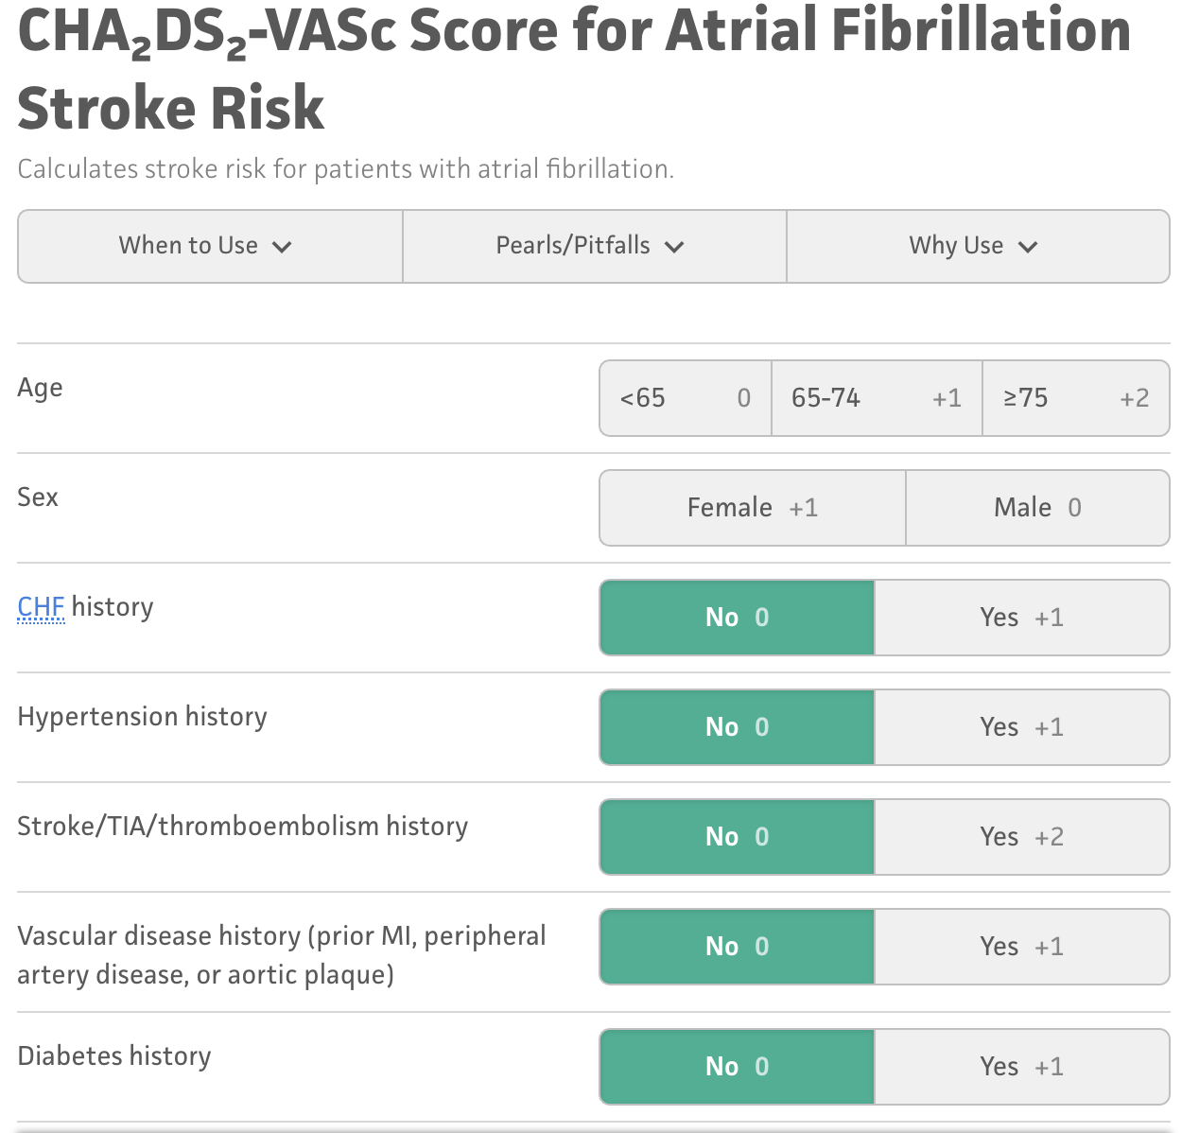
Example clinical prediction model
Amongst patients newly diagnosed with afib which patients will go on to have stroke within 1-year?

Slide 13
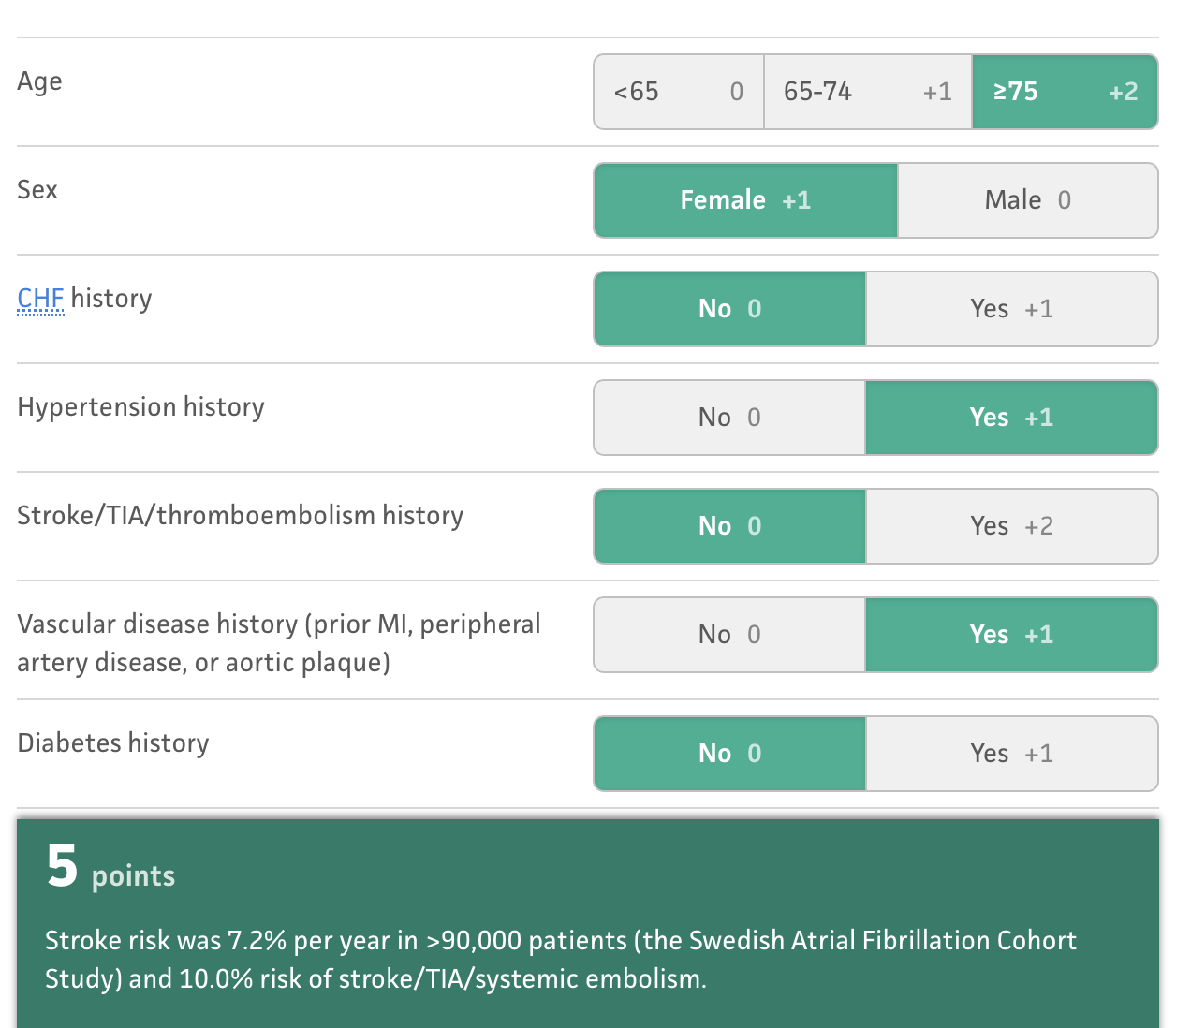
Example clinical prediction model
For a female Afib patient aged 78 with a history of hypertension and vascular disease, the patient’s risk of stroke is 7.2% in the next year.

Slide 14
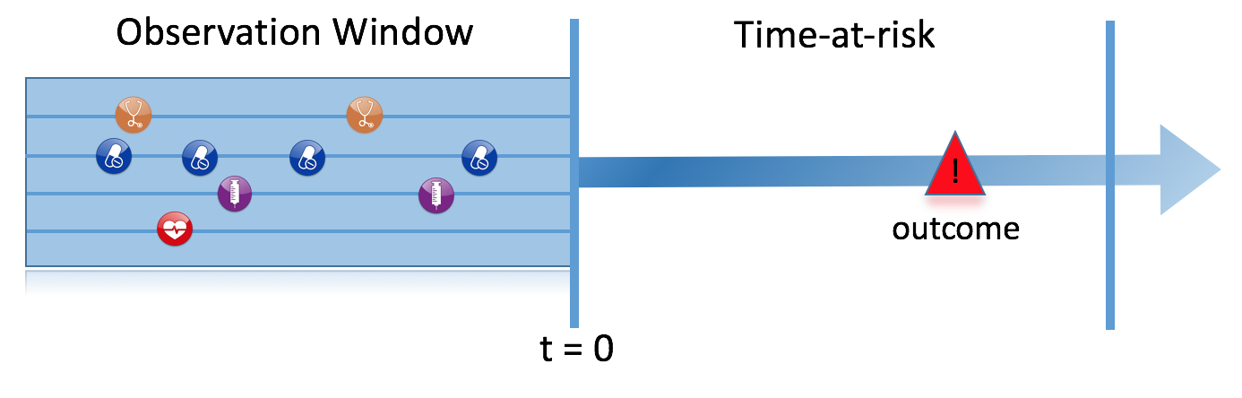
Prediction Problem Definition
Among a target population (T), we aim to predict which patients at a defined moment in time (t=0) will experience some outcome (O) during a time-at-risk Prediction is done using only information about the patients in an observation window prior to that moment in time.

Slide 15
What are the key inputs to a patient-level prediction study?
Input parameter | Design choice
Target cohort (T)
Outcome cohort (O)
Time-at-risk
Model development -which algorithm(s)? -which parameters? -which covariates?
We extract data for the patients in the Target Cohort (T) of which some will experience the outcome (O) in T
T
O

Slide 16
Types of prediction problems in healthcare
Type | Structure | Example
Disease onset and progression | Amongst patients who are newly diagnosed with <insert your favorite disease>, which patients will go on to have <another disease or related complication> within <time horizon from diagnosis>? | Among newly diagnosed AFib patients, which will go onto to have ischemic stroke in next 3 years?
Treatment choice | Amongst patients with <indicated disease> who are treated with either <treatment 1> or <treatment 2>, which patients were treated with <treatment 1> (on day 0)? | Among AFib patients who took either warfarin or rivaroxaban, which patients got warfarin? (as defined for propensity score model)
Treatment response | Amongst patients who are new users of <insert your favorite chronically-used drug>, which patients will <insert desired effect> in <time window>? | Which patients with T2DM who start on metformin stay on metformin after 3 years?
Treatment safety | Amongst patients who are new users of <insert your favorite drug>, which patients will experience <insert your favorite known adverse event from the drug profile> within <time horizon following exposure start>? | Among new users of warfarin, which patients will have GI bleed in 1 year?
Treatment adherence | Amongst patients who are new users of <insert your favorite chronically-used drug>, which patients will achieve <adherence metric threshold> at <time horizon>? | Which patients with T2DM who start on metformin achieve >=80% proportion of days covered at 1 year?

Slide 17
Types of prediction problems in healthcare
Type | Structure | Example
Disease onset and progression | Amongst patients who are newly diagnosed with <insert your favorite disease>, which patients will go on to have <another disease or related complication> within <time horizon from diagnosis>? | Among newly diagnosed AFib patients, which will go onto to have ischemic stroke in next 3 years?
Treatment choice | Amongst patients with <indicated disease> who are treated with either <treatment 1> or <treatment 2>, which patients were treated with <treatment 1> (on day 0)? | Among AFib patients who took either warfarin or rivaroxaban, which patients got warfarin? (as defined for propensity score model)
Treatment response | Amongst patients who are new users of <insert your favorite chronically-used drug>, which patients will <insert desired effect> in <time window>? | Which patients with T2DM who start on metformin stay on metformin after 3 years?
Treatment safety | Amongst patients who are new users of <insert your favorite drug>, which patients will experience <insert your favorite known adverse event from the drug profile> within <time horizon following exposure start>? | Among new users of warfarin, which patients will have GI bleed in 1 year?
Treatment adherence | Amongst patients who are new users of <insert your favorite chronically-used drug>, which patients will achieve <adherence metric threshold> at <time horizon>? | Which patients with T2DM who start on metformin achieve >=80% proportion of days covered at 1 year?
Type | Structure
Disease onset and progression | Amongst patients who are newly diagnosed with <insert your favorite disease>, which patients will go on to have <another disease or related complication> within <time horizon from diagnosis>? Among newly diagnosed AFib patients, which will go onto to have ischemic stroke in next 3 years?

Slide 18
Types of prediction problems in healthcare
Type | Structure | Example
Disease onset and progression | Amongst patients who are newly diagnosed with <insert your favorite disease>, which patients will go on to have <another disease or related complication> within <time horizon from diagnosis>? | Among newly diagnosed AFib patients, which will go onto to have ischemic stroke in next 3 years?
Treatment choice | Amongst patients with <indicated disease> who are treated with either <treatment 1> or <treatment 2>, which patients were treated with <treatment 1> (on day 0)? | Among AFib patients who took either warfarin or rivaroxaban, which patients got warfarin? (as defined for propensity score model)
Treatment response | Amongst patients who are new users of <insert your favorite chronically-used drug>, which patients will <insert desired effect> in <time window>? | Which patients with T2DM who start on metformin stay on metformin after 3 years?
Treatment safety | Amongst patients who are new users of <insert your favorite drug>, which patients will experience <insert your favorite known adverse event from the drug profile> within <time horizon following exposure start>? | Among new users of warfarin, which patients will have GI bleed in 1 year?
Treatment adherence | Amongst patients who are new users of <insert your favorite chronically-used drug>, which patients will achieve <adherence metric threshold> at <time horizon>? | Which patients with T2DM who start on metformin achieve >=80% proportion of days covered at 1 year?
Type | Structure
Treatment choice | Amongst patients with <indicated disease> who are treated with either <treatment 1> or <treatment 2>, which patients were treated with <treatment 1> (on day 0)? Among AFib patients who took either warfarin or rivaroxaban, which patients got warfarin? (as defined for propensity score model)

Slide 19
Types of prediction problems in healthcare
Type | Structure | Example
Disease onset and progression | Amongst patients who are newly diagnosed with <insert your favorite disease>, which patients will go on to have <another disease or related complication> within <time horizon from diagnosis>? | Among newly diagnosed AFib patients, which will go onto to have ischemic stroke in next 3 years?
Treatment choice | Amongst patients with <indicated disease> who are treated with either <treatment 1> or <treatment 2>, which patients were treated with <treatment 1> (on day 0)? | Among AFib patients who took either warfarin or rivaroxaban, which patients got warfarin? (as defined for propensity score model)
Treatment response | Amongst patients who are new users of <insert your favorite chronically-used drug>, which patients will <insert desired effect> in <time window>? | Which patients with T2DM who start on metformin stay on metformin after 3 years?
Treatment safety | Amongst patients who are new users of <insert your favorite drug>, which patients will experience <insert your favorite known adverse event from the drug profile> within <time horizon following exposure start>? | Among new users of warfarin, which patients will have GI bleed in 1 year?
Treatment adherence | Amongst patients who are new users of <insert your favorite chronically-used drug>, which patients will achieve <adherence metric threshold> at <time horizon>? | Which patients with T2DM who start on metformin achieve >=80% proportion of days covered at 1 year?
Type | Structure
Treatment response | Amongst patients who are new users of <insert your favorite chronically-used drug>, which patients will <insert desired effect> in <time window>? Which patients with T2DM who start on metformin stay on metformin after 3 years?

Slide 20
Types of prediction problems in healthcare
Type | Structure | Example
Disease onset and progression | Amongst patients who are newly diagnosed with <insert your favorite disease>, which patients will go on to have <another disease or related complication> within <time horizon from diagnosis>? | Among newly diagnosed AFib patients, which will go onto to have ischemic stroke in next 3 years?
Treatment choice | Amongst patients with <indicated disease> who are treated with either <treatment 1> or <treatment 2>, which patients were treated with <treatment 1> (on day 0)? | Among AFib patients who took either warfarin or rivaroxaban, which patients got warfarin? (as defined for propensity score model)
Treatment response | Amongst patients who are new users of <insert your favorite chronically-used drug>, which patients will <insert desired effect> in <time window>? | Which patients with T2DM who start on metformin stay on metformin after 3 years?
Treatment safety | Amongst patients who are new users of <insert your favorite drug>, which patients will experience <insert your favorite known adverse event from the drug profile> within <time horizon following exposure start>? | Among new users of warfarin, which patients will have GI bleed in 1 year?
Treatment adherence | Amongst patients who are new users of <insert your favorite chronically-used drug>, which patients will achieve <adherence metric threshold> at <time horizon>? | Which patients with T2DM who start on metformin achieve >=80% proportion of days covered at 1 year?
Type | Structure
Treatment safety | Amongst patients who are new users of <insert your favorite drug>, which patients will experience <insert your favorite known adverse event from the drug profile> within <time horizon following exposure start>? Among new users of warfarin, which patients will have GI bleed in 1 year?

Slide 21
Types of prediction problems in healthcare
Type | Structure | Example
Disease onset and progression | Amongst patients who are newly diagnosed with <insert your favorite disease>, which patients will go on to have <another disease or related complication> within <time horizon from diagnosis>? | Among newly diagnosed AFib patients, which will go onto to have ischemic stroke in next 3 years?
Treatment choice | Amongst patients with <indicated disease> who are treated with either <treatment 1> or <treatment 2>, which patients were treated with <treatment 1> (on day 0)? | Among AFib patients who took either warfarin or rivaroxaban, which patients got warfarin? (as defined for propensity score model)
Treatment response | Amongst patients who are new users of <insert your favorite chronically-used drug>, which patients will <insert desired effect> in <time window>? | Which patients with T2DM who start on metformin stay on metformin after 3 years?
Treatment safety | Amongst patients who are new users of <insert your favorite drug>, which patients will experience <insert your favorite known adverse event from the drug profile> within <time horizon following exposure start>? | Among new users of warfarin, which patients will have GI bleed in 1 year?
Treatment adherence | Amongst patients who are new users of <insert your favorite chronically-used drug>, which patients will achieve <adherence metric threshold> at <time horizon>? | Which patients with T2DM who start on metformin achieve >=80% proportion of days covered at 1 year?
Type | Structure
Treatment adherence | Amongst patients who are new users of <insert your favorite chronically-used drug>, which patients will achieve <adherence metric threshold> at <time horizon>? Which patients with T2DM who start on metformin achieve >=80% proportion of days covered at 1 year?

Slide 22
How to pick a clinically useful task?
Think about:
Is there a current medical decision you find difficult?
Is there a clear point in time you can apply a prediction model to help with the decision? (e.g., visit when first diagnosed)
Is the target and outcome recorded in our OHDSI data?
How common is the outcome? If you could identify a group of patients with 10x the population average risk would that help?

Slide 23
Types of prediction problems in healthcare
Type | Structure | Example
Disease onset and progression | Amongst patients who are newly diagnosed with <insert your favorite disease>, which patients will go on to have <another disease or related complication> within <time horizon from diagnosis>? | Among newly diagnosed AFib patients, which will go onto to have ischemic stroke in next 3 years?
Treatment choice | Amongst patients with <indicated disease> who are treated with either <treatment 1> or <treatment 2>, which patients were treated with <treatment 1> (on day 0)? | Among AFib patients who took either warfarin or rivaroxaban, which patients got warfarin? (as defined for propensity score model)
Treatment response | Amongst patients who are new users of <insert your favorite chronically-used drug>, which patients will <insert desired effect> in <time window>? | Which patients with T2DM who start on metformin stay on metformin after 3 years?
Treatment safety | Amongst patients who are new users of <insert your favorite drug>, which patients will experience <insert your favorite known adverse event from the drug profile> within <time horizon following exposure start>? | Among new users of warfarin, which patients will have GI bleed in 1 year?
Treatment adherence | Amongst patients who are new users of <insert your favorite chronically-used drug>, which patients will achieve <adherence metric threshold> at <time horizon>? | Which patients with T2DM who start on metformin achieve >=80% proportion of days covered at 1 year?

Slide 25
Today’s Agenda
Time | Topic
12:45 - 13:00 | Get settled, get laptops ready
13:00 – 13:30 | Presentation: What is Patient-Level Prediction
13:30 – 13:45 | Exercise: Design your own prediction task
13:45 – 14:00 | Break
14:00 – 14:30 | Presentation: OHDSI Patient-Level Prediction With Best Practices
14:30 – 15:00 | Exercise: Design your own model
15:00 – 15:15 | Break
15:15 – 16:00 | Presentation: Using R to implement your design and run a network study
16:00 – 16:15 | Demo: Exploring study results via shiny
16:15 - 16:30 | Break
16:30 - 16:45 | Presentation: Federated Learning
16:45 – 17:00 | Lessons Learned and Feedback

Slide 26
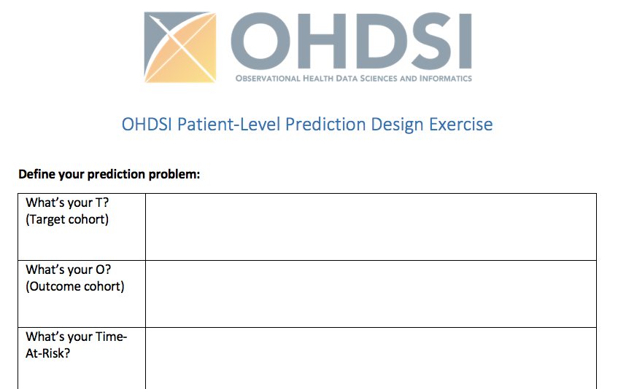
What is your prediction problem?
Fill in your form in small groups (15 min)
Think about:
Will these patients be identifiable in the data?
Is there a medical question this can aid?
Is there an intervention this can help?
Notes:
(Pop settings) Should you exclude people with prior O? Require min observation? First exposure only?

Slide 27
Today’s Agenda
Time | Topic
12:45 - 13:00 | Get settled, get laptops ready
13:00 – 13:30 | Presentation: What is Patient-Level Prediction
13:30 – 13:45 | Exercise: Design your own prediction task
13:45 – 14:00 | Break
14:00 – 14:30 | Presentation: OHDSI Patient-Level Prediction With Best Practices
14:30 – 15:00 | Exercise: Design your own model
15:00 – 15:15 | Break
15:15 – 16:00 | Presentation: Using R to implement your design and run a network study
16:00 – 16:15 | Demo: Exploring study results via shiny
16:15 - 16:30 | Break
16:30 - 16:45 | Presentation: Federated Learning
16:45 – 17:00 | Lessons Learned and Feedback

Slide 28

Let’s take a 15 min break
Be back by 2pm

Slide 29
Today’s Agenda
Time | Topic
12:45 - 13:00 | Get settled, get laptops ready
13:00 – 13:30 | Presentation: What is Patient-Level Prediction
13:30 – 13:45 | Exercise: Design your own prediction task
13:45 – 14:00 | Break
14:00 – 14:30 | Presentation: OHDSI Patient-Level Prediction With Best Practices
14:30 – 15:00 | Exercise: Design your own model
15:00 – 15:15 | Break
15:15 – 16:00 | Presentation: Using R to implement your design and run a network study
16:00 – 16:15 | Demo: Exploring study results via shiny
16:15 - 16:30 | Break
16:30 - 16:45 | Presentation: Federated Learning
16:45 – 17:00 | Lessons Learned and Feedback

Slide 30
OHDSI PLP Framework with Best Practices
Jenna Reps

Slide 31
Things to cover in 30-45 mins
Extracting the data (cohort vs case control, features, etc)
Learning the model (hyperparams, split, classifier choice, etc)
OHDSI PLP model design components (split settings, modelSettings, covariateSettings, populationSettings, plpDataSettings, sample, featureEngineering, tidyCovariateSettings)
Evaluating the model (AUROC, calibration, …)

Slide 32
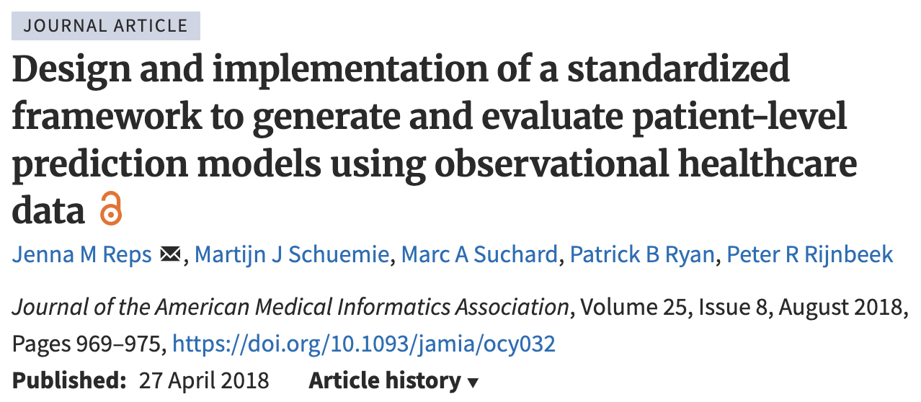
The OHDSI PLP Framework
Training
Internal Validation
Data Extraction
External Validation
Dissemination
Problem Definition
Model development
Model sharing
Creating the data to learn from
Model validation

Slide 33

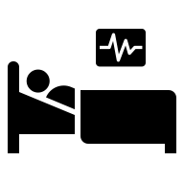
Data Extraction: Cohort vs case-control design
Case-control Design
People with the outcome
See what happened before outcome
Problems:
How to select non-outcomes?
When is index for non-outcomes?
How to handle records related to outcome diagnosis?
People without outcome
Transparent task
Clear index
No issue with outcome related features
Cohort Design
See who gets outcome
People at risk (Target)

Slide 34
Data Extraction: Cohort vs case-control design
Nested case-control Design
People with the outcome in some target population
See what happened before outcome
People without outcome in some target population
Less problematic but index for non-outcomes still unclear.
Reps, J.M., Ryan, P.B., Rijnbeek, P.R. et al. Design matters in patient-level prediction: evaluation of a cohort vs. case-control design when developing predictive models in observational healthcare datasets. J Big Data 8, 108 (2021). https://doi.org/10.1186/s40537-021-00501-2
Cohort Design
See who gets outcome
People at risk (Target)
BP: Generally recommended to use cohort design

Slide 35
Extracting labelled data
Training
Internal Validation
Data Extraction
External Validation
Dissemination
Problem Definition
How to address loss to follow-up?
What predictors to include?
Binary outcome or survival model?
Other PROBAST
Cohort Design
See who gets outcome
People at risk (Target)
We find people in the data who historically match our target population and we follow them for the time-at-risk to see whether they had the outcome or not.

Slide 36
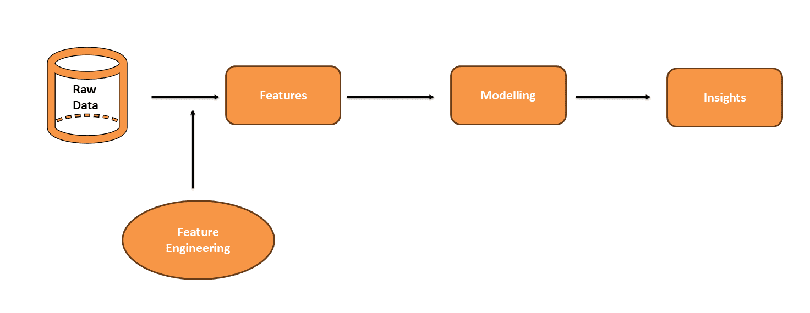
Predictors
Training
Internal Validation
Data Extraction
External Validation
Dissemination
Problem Definition
FeatureExtraction library
Cohorts as features – constrained set
Feature engineering

Slide 37
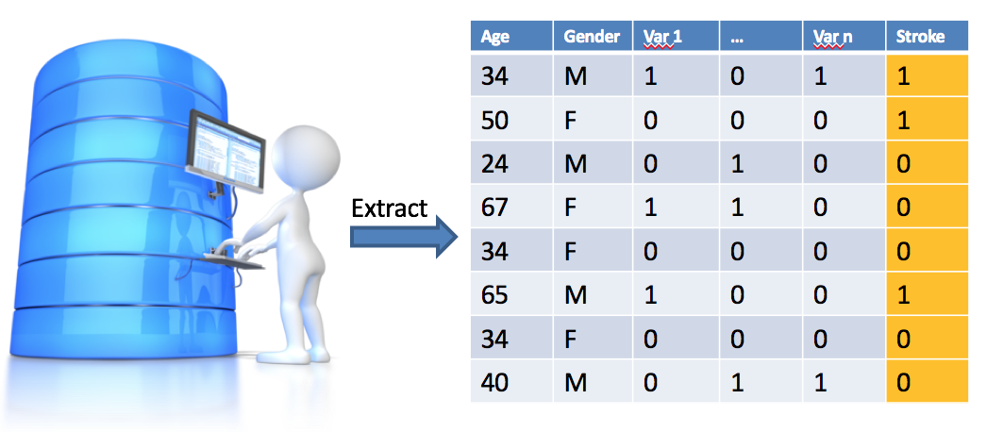
Create labelled data using retrospective cohort design
Training
Internal Validation
Data Extraction
External Validation
Dissemination
Problem Definition
Data is extracted from the OMOP CDM using the Feature Extraction R-Package.
This allows for specification of the candidate predictors and time windows.

Slide 38
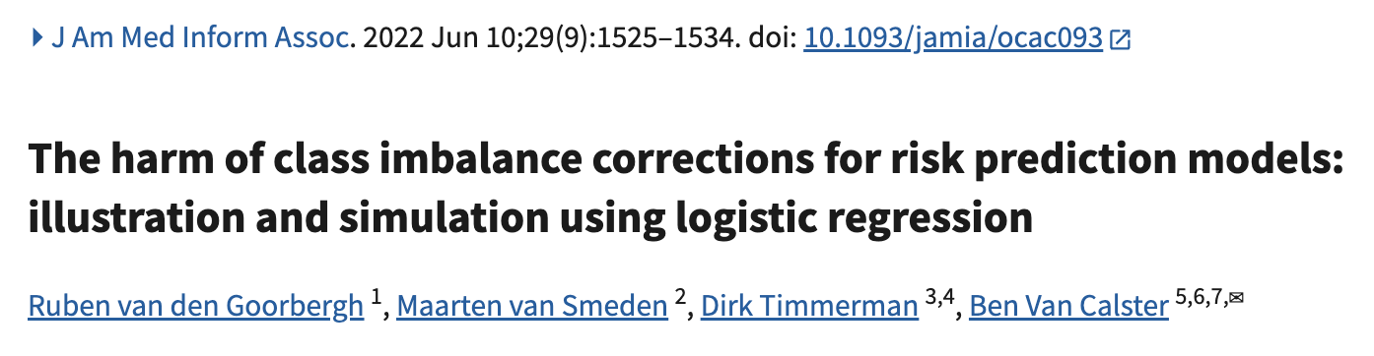
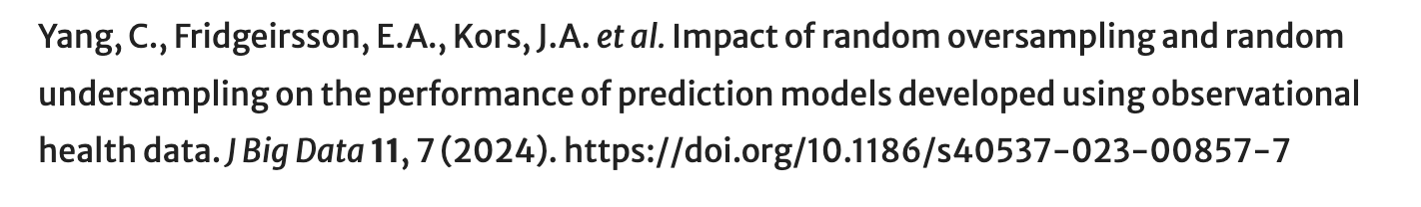
Imbalanced labels
Training
Internal Validation
Data Extraction
External Validation
Dissemination
Problem Definition
Question: Should you do over/under sampling to balance class labels?
BP: Be careful as can lead to calibration issues

Slide 39
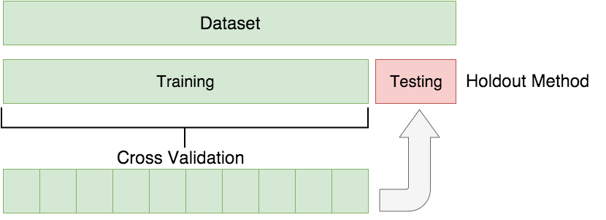
Developing the model
Training
Internal Validation
Data Extraction
External Validation
Dissemination
Problem Definition
Splitting the labelled data into disjoint sets:
Training: Used to develop the model (using cross validation)
Testing: Used to internally evaluate the model
Cross validation is used to evaluate different hyperparameters

Slide 40
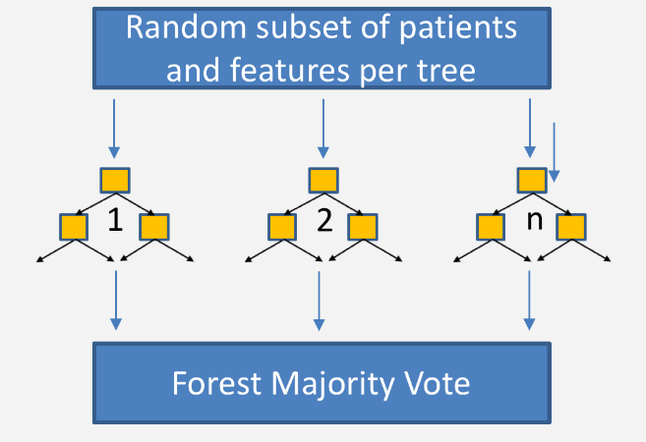
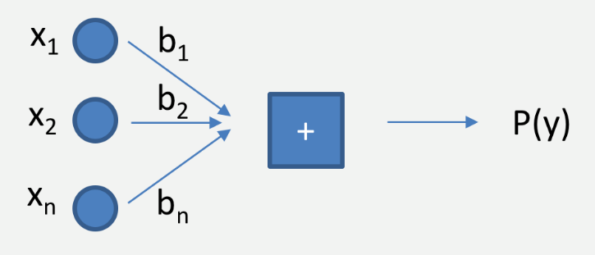
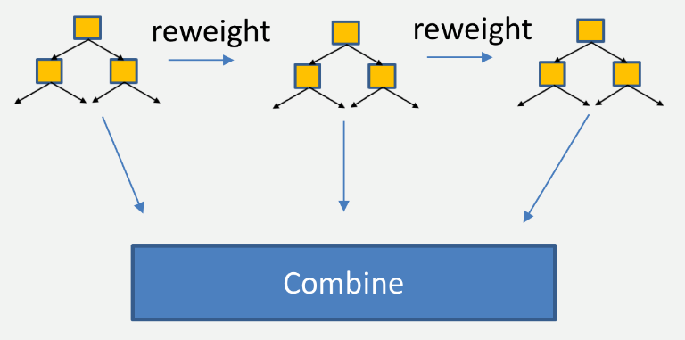
Developing the model
Training
Internal Validation
Data Extraction
External Validation
Dissemination
Problem Definition
Regularized Logistic Regression
Random Forest
Gradient Boosting Machines
Many other models for example:
K-nearest neighbors
Naïve Bayes
Decision Tree
Adaboost
Neural Network
Deep Learning
Etc.
BP: If you are not time constrained, try different classifiers

Slide 41
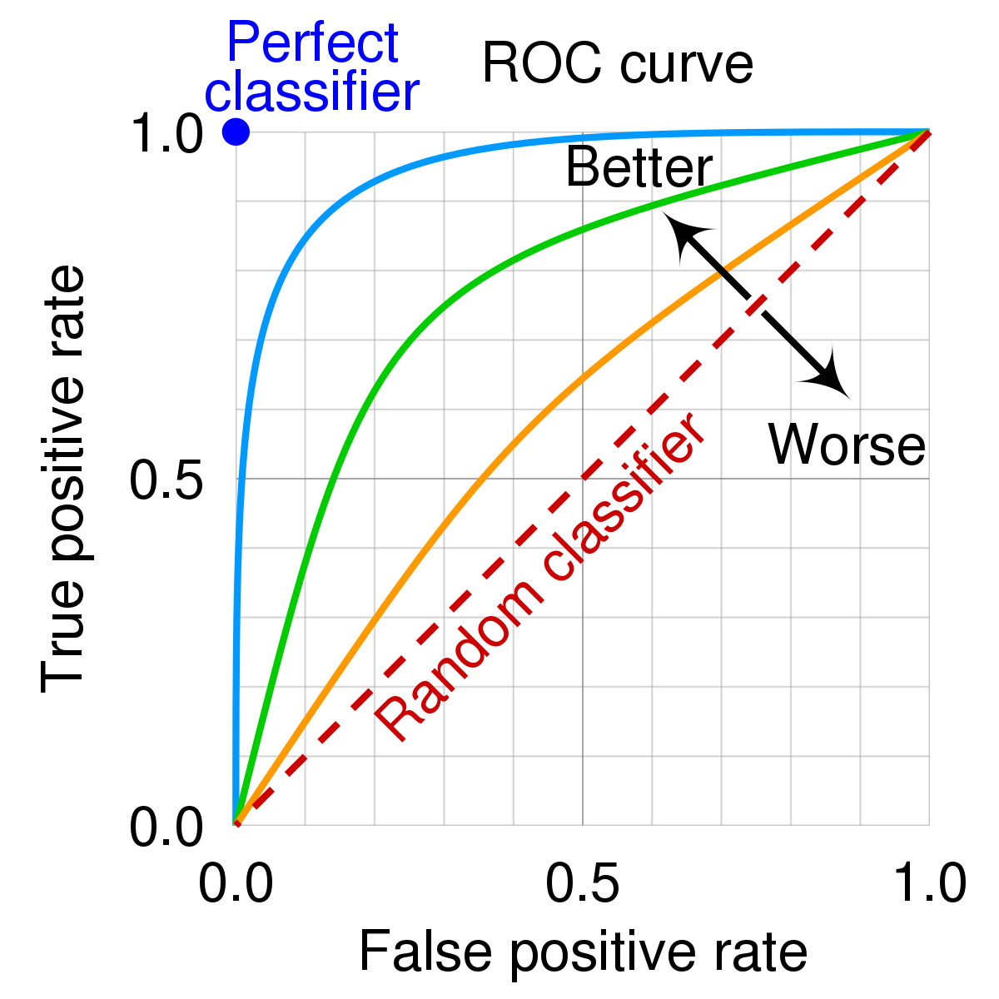
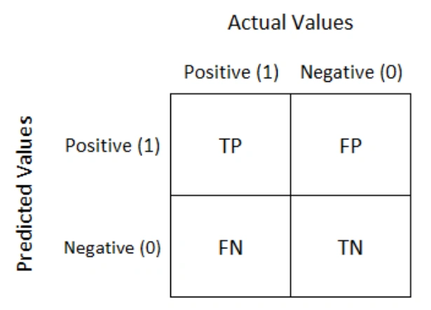
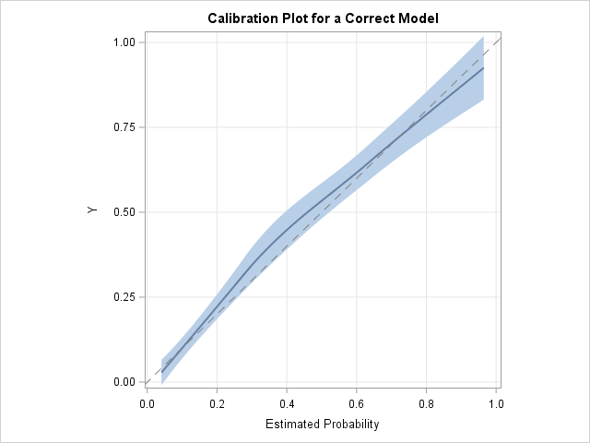
Evaluating the model
Training
Internal Validation
Data Extraction
External Validation
Dissemination
Problem Definition
What makes a good model?
Discrimination: differentiates between those with and without the event, i.e. predicts higher probabilities for those with the event compared to those who don’t experience the event
Calibration: estimated probabilities are close to the observed frequency
BP: Use standard performance metrics to enable comparison

Slide 42
Evaluating the model
Training
Internal Validation
Data Extraction
External Validation
Dissemination
Problem Definition
We held out some of the labelled data into the testing set – we can then apply the model to those patients and compare the predicted risk with the truth outcome status.
BP: Should always do some form of internal validation (CV, leave-one-out, bootstrapping or using a test set).

Slide 43

Evaluating the model
Training
Internal Validation
Data Extraction
External Validation
Dissemination
Problem Definition
External validation is performed using
data from multiple populations not
used for training.
Train
Apply
Evaluate
2
Auc2, Cal2
1
Model
3
Auc3, Cal3
4
Auc4, Cal4
Needed if you want to create a general model that will be applied outside the development database

Slide 44
Publishing the model
Training
Internal Validation
Data Extraction
External Validation
Dissemination
Problem Definition
Dissemination of study results should follow the minimum requirements as stated in the Transparent Reporting of a multivariable prediction model for Individual Prognosis Or Diagnosis (TRIPOD) statement ¹.
https://www.equator-network.org/reporting-guidelines/tripod-statement/
Internal and external validation
Sharing of full model details
Sharing of all analyses code to allow full reproducibility
Website to share protocol, code, models and results for all databases

Slide 45


Questions?

Slide 46
Today’s Agenda
Time | Topic
12:45 - 13:00 | Get settled, get laptops ready
13:00 – 13:30 | Presentation: What is Patient-Level Prediction
13:30 – 13:45 | Exercise: Design your own prediction task
13:45 – 14:00 | Break
14:00 – 14:30 | Presentation: OHDSI Patient-Level Prediction With Best Practices
14:30 – 15:00 | Exercise: Design your own model
15:00 – 15:15 | Break
15:15 – 16:00 | Presentation: Using R to implement your design and run a network study
16:00 – 16:15 | Demo: Exploring study results via shiny
16:15 - 16:30 | Break
16:30 - 16:45 | Presentation: Federated Learning
16:45 – 17:00 | Lessons Learned and Feedback

Slide 47
Design your model
Study design: must be cohort design
Features:
(optional) Feature engineering:
(optional) Class sample settings: not recommended
Data split settings:
Classifier (or set of classifiers):
Notes:
Discuss preprocessing data – normalization?

Slide 48
Today’s Agenda
Time | Topic
12:45 - 13:00 | Get settled, get laptops ready
13:00 – 13:30 | Presentation: What is Patient-Level Prediction
13:30 – 13:45 | Exercise: Design your own prediction task
13:45 – 14:00 | Break
14:00 – 14:30 | Presentation: OHDSI Patient-Level Prediction With Best Practices
14:30 – 15:00 | Exercise: Design your own model
15:00 – 15:15 | Break
15:15 – 16:00 | Presentation: Using R to implement your design and run a network study
16:00 – 16:15 | Demo: Exploring study results via shiny
16:15 - 16:30 | Break
16:30 - 16:45 | Presentation: Federated Learning
16:45 – 17:00 | Lessons Learned and Feedback

Slide 49
Let’s take a 15 min break
Be back by 3:15pm

Slide 50
Today’s Agenda
Time | Topic
12:45 - 13:00 | Get settled, get laptops ready
13:00 – 13:30 | Presentation: What is Patient-Level Prediction
13:30 – 13:45 | Exercise: Design your own prediction task
13:45 – 14:00 | Break
14:00 – 14:30 | Presentation: OHDSI Patient-Level Prediction With Best Practices
14:30 – 15:00 | Exercise: Design your own model
15:00 – 15:15 | Break
15:15 – 16:00 | Presentation: Using R to implement your design and run a network study
16:00 – 16:15 | Demo: Exploring study results via shiny
16:15 - 16:30 | Break
16:30 - 16:45 | Presentation: Federated Learning
16:45 – 17:00 | Lessons Learned and Feedback

Slide 51
Live Demo Developing models using the PatientLevelPrediction R package
Egill Fridgeirsson

Slide 52
Move over to markdown html
Add link here

Slide 53
Today’s Agenda
Time | Topic
12:45 - 13:00 | Get settled, get laptops ready
13:00 – 13:30 | Presentation: What is Patient-Level Prediction
13:30 – 13:45 | Exercise: Design your own prediction task
13:45 – 14:00 | Break
14:00 – 14:30 | Presentation: OHDSI Patient-Level Prediction With Best Practices
14:30 – 15:00 | Exercise: Design your own model
15:00 – 15:15 | Break
15:15 – 16:00 | Presentation: Using R to implement your design and run a network study
16:00 – 16:15 | Demo: Exploring study results via shiny
16:15 - 16:30 | Break
16:30 - 16:45 | Presentation: Federated Learning
16:45 – 17:00 | Lessons Learned and Feedback

Slide 54
Today’s Agenda
Time | Topic
12:45 - 13:00 | Get settled, get laptops ready
13:00 – 13:30 | Presentation: What is Patient-Level Prediction
13:30 – 13:45 | Exercise: Design your own prediction task
13:45 – 14:00 | Break
14:00 – 14:30 | Presentation: OHDSI Patient-Level Prediction With Best Practices
14:30 – 15:00 | Exercise: Design your own model
15:00 – 15:15 | Break
15:15 – 16:00 | Presentation: Using R to implement your design and run a network study
16:00 – 16:15 | Demo: Exploring study results via shiny
16:15 - 16:30 | Break
16:30 - 16:45 | Presentation: Federated Learning
16:45 – 17:00 | Lessons Learned and Feedback

Slide 55
Let’s take a 15 min break
Be back by 4:30pm

Slide 56
Today’s Agenda
Time | Topic
12:45 - 13:00 | Get settled, get laptops ready
13:00 – 13:30 | Presentation: What is Patient-Level Prediction
13:30 – 13:45 | Exercise: Design your own prediction task
13:45 – 14:00 | Break
14:00 – 14:30 | Presentation: OHDSI Patient-Level Prediction With Best Practices
14:30 – 15:00 | Exercise: Design your own model
15:00 – 15:15 | Break
15:15 – 16:00 | Presentation: Using R to implement your design and run a network study
16:00 – 16:15 | Demo: Exploring study results via shiny
16:15 - 16:30 | Break
16:30 - 16:45 | Presentation: Federated Learning
16:45 – 17:00 | Lessons Learned and Feedback

Slide 57
Today’s Agenda
Time | Topic
12:45 - 13:00 | Get settled, get laptops ready
13:00 – 13:30 | Presentation: What is Patient-Level Prediction
13:30 – 13:45 | Exercise: Design your own prediction task
13:45 – 14:00 | Break
14:00 – 14:30 | Presentation: OHDSI Patient-Level Prediction With Best Practices
14:30 – 15:00 | Exercise: Design your own model
15:00 – 15:15 | Break
15:15 – 16:00 | Presentation: Using R to implement your design and run a network study
16:00 – 16:15 | Demo: Exploring study results via shiny
16:15 - 16:30 | Break
16:30 - 16:45 | Presentation: Federated Learning
16:45 – 17:00 | Lessons Learned and Feedback

Slide 58
OHDSI Federated Learning

Slide 59
Lessons learned and feedback

Slide 60
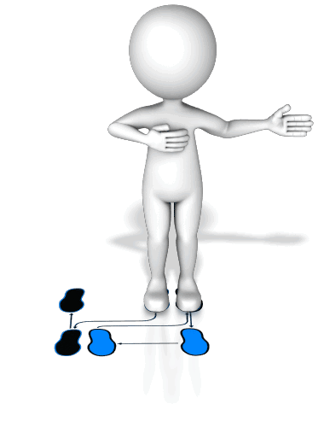

Lessons Learned
Learned the PLP Dance
Educated Fortune Teller

Slide 61
What’s Next?
Do you still think your prediction task can help? If so, write a network study for your model and get the community to build it. If not, can you think of a different task?
R-package
www.github.com/OHDSI/PatientLevelPrediction
Vignettes
Videos
Online training material
Book-of-OHDSI https://ohdsi.github.io/TheBookOfOhdsi/
Study Results
www.data.ohdsi.org

Slide 62

Join the PLP Community
Monthly meetings of PLP WG
Researchers Forum
(tag patientprediction)
Become an active developer: add your own algorithms and other features

Slide 63


Continuation of the PLP Journey
Scale up
Increase the number of database
Increase the number of cohorts at risk
Increase the number of outcomes
Method Research
Performance
Transportability
Temporal information
Textual information
Deep learning
Ensemble training
Learning Curves
Clinical impact for the patient
How to assess?
Tool Development
Model Library
Results viewer improvements.

Slide 64
Tutorial improvement
We like to hear your feedback on this course:
What went well?
What did not?
What do you like to see added?
You can give your feedback on the evaluation form:
https://bit.ly/2EeSIpC

Slide 65


Questions? Drop us an email
jreps@its.jnj.com
Notes:
I like to keep these two slides in, they will not take time.

